Slide 1
Spadoni College of Education
Coastal Carolina University
Please open your chat to ask questions and visit https://www.coastal.edu/graduatestudies/ to request more information
Graduate Programs

Slide 2
Graduate Degrees At CCU
Master's in Education Programs
Master of Education in Instructional Technology (M.Ed.)
Fully Online Program
12 to 18 months
Master of Education in Language, Literacy and Culture (M.Ed.)
Hybrid Program
18 months-2 years
Master of Education in Special Education (M.Ed.)
Fully Online Program
18 months
Master of Education in Educational Leadership (M.Ed.)
Hybrid Program
2 years
Please open your chat to ask questions and visit https://www.coastal.edu/graduatestudies/ to request more information
Educational Specialist Programs
Educational Specialist in Educational Leadership (Ed.S.)
Hybrid Program
2 years
Educational Specialist in Instructional Technology (Ed.S.)
Fully Online Program
12 to 18 months

Slide 3
Graduate Degrees At CCU
Initial Certification
Master of Arts in Teaching (M.A.T.)
14 Months
Science, Math, Social Studies, and English
Starts May 1st
Hybrid Program
Please open your chat to ask questions and visit https://www.coastal.edu/graduatestudies/ to request more information

Slide 4
Graduate Degrees at CCU
Doctoral Program
The Ph.D. program will involve students in developing the breadth and depth of understandings, skills, and dispositions through study in one of three specialization areas:
Educational Leadership
Higher Education Administration
Curriculum, Instruction, and Assessment
Follows an executive cohort model. Classes will be hybrid. With Saturday delivery on campus.
First cohort began January 2019.
Please open your chat to ask questions and visit https://www.coastal.edu/graduatestudies/ to request more information

Slide 5
Add-ons and Certifications at CCU
Literacy Teacher Add-on Certification*
Offering courses required towards certification
Literacy Coach Add-on Certification*
Offering courses required towards certification
ESOL Certificate*
Offering courses required towards certification
Certificate in Online Teaching and Training
12-credit 100 percent online graduate program
Special Education Add-on
Four options available: Specific Learning Disabilities, Emotional Disabilities, Intellectual Disabilities, or Severe Disabilities.
*The Spadoni College of Education offers the coursework licensed educators may use to apply for add-on certification by the South Carolina Department of Education for Literacy Teacher and Literacy Coach.
Please open your chat to ask questions and visit https://www.coastal.edu/graduatestudies/ to request more information

Slide 6
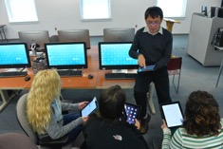
Instructional Technology
Ed.S. Instructional Technology
100% online
10 classes (30 credits)
18 months
Post-masters
M+30 pay
M.Ed. Instructional Technology
100% online
10 classes (30 credits)
18 months
Post-bachelors
M-level pay
Certificate Online Teaching & Training
100% online
4 classes (12 credits)
Summer
Integrated into M.Ed.
Add-on endorsement
Please open your chat to ask questions and visit https://www.coastal.edu/graduatestudies/ to request more information

Slide 7
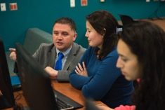
Educational Leadership
Ed.S. Educational Leadership
Hybrid program
11 classes (33 credits)
2 years
Post-masters
M+30 pay
M.Ed. Educational Leadership
Hybrid program
36 credits
2-3 years
Post-bachelors
M-level pay
Please open your chat to ask questions and visit https://www.coastal.edu/graduatestudies/ to request more information

Slide 8
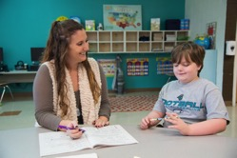
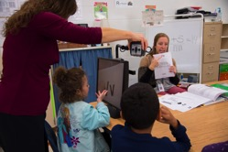
Special Education
M.Ed. Special Education
100% Online
30 credits
18 months
Post-bachelors
M-level pay
Add-on Licensure
7 courses (21 credits)
Four concentration areas
Specific Learning Disabilities, Emotional Disabilities, Intellectual Disabilities, or Severe Disabilities.
Please open your chat to ask questions and visit https://www.coastal.edu/graduatestudies/ to request more information

Slide 9
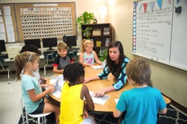
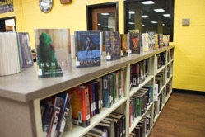
Language, Literacy, and Culture
M.Ed. Language, Literacy, and Culture
Hybrid delivery
33 credits
2 years
Post-bachelors
M-level pay
Literacy Add-On Certifications
‌Literacy Teacher Add-on Certification
100% Online
12 credits
Literacy Coach Add-on Certification
100% Online
12 credits
English for Speakers of Other Languages Certificate
100% Online
15 credits
Please open your chat to ask questions and visit https://www.coastal.edu/graduatestudies/ to request more information

Slide 10
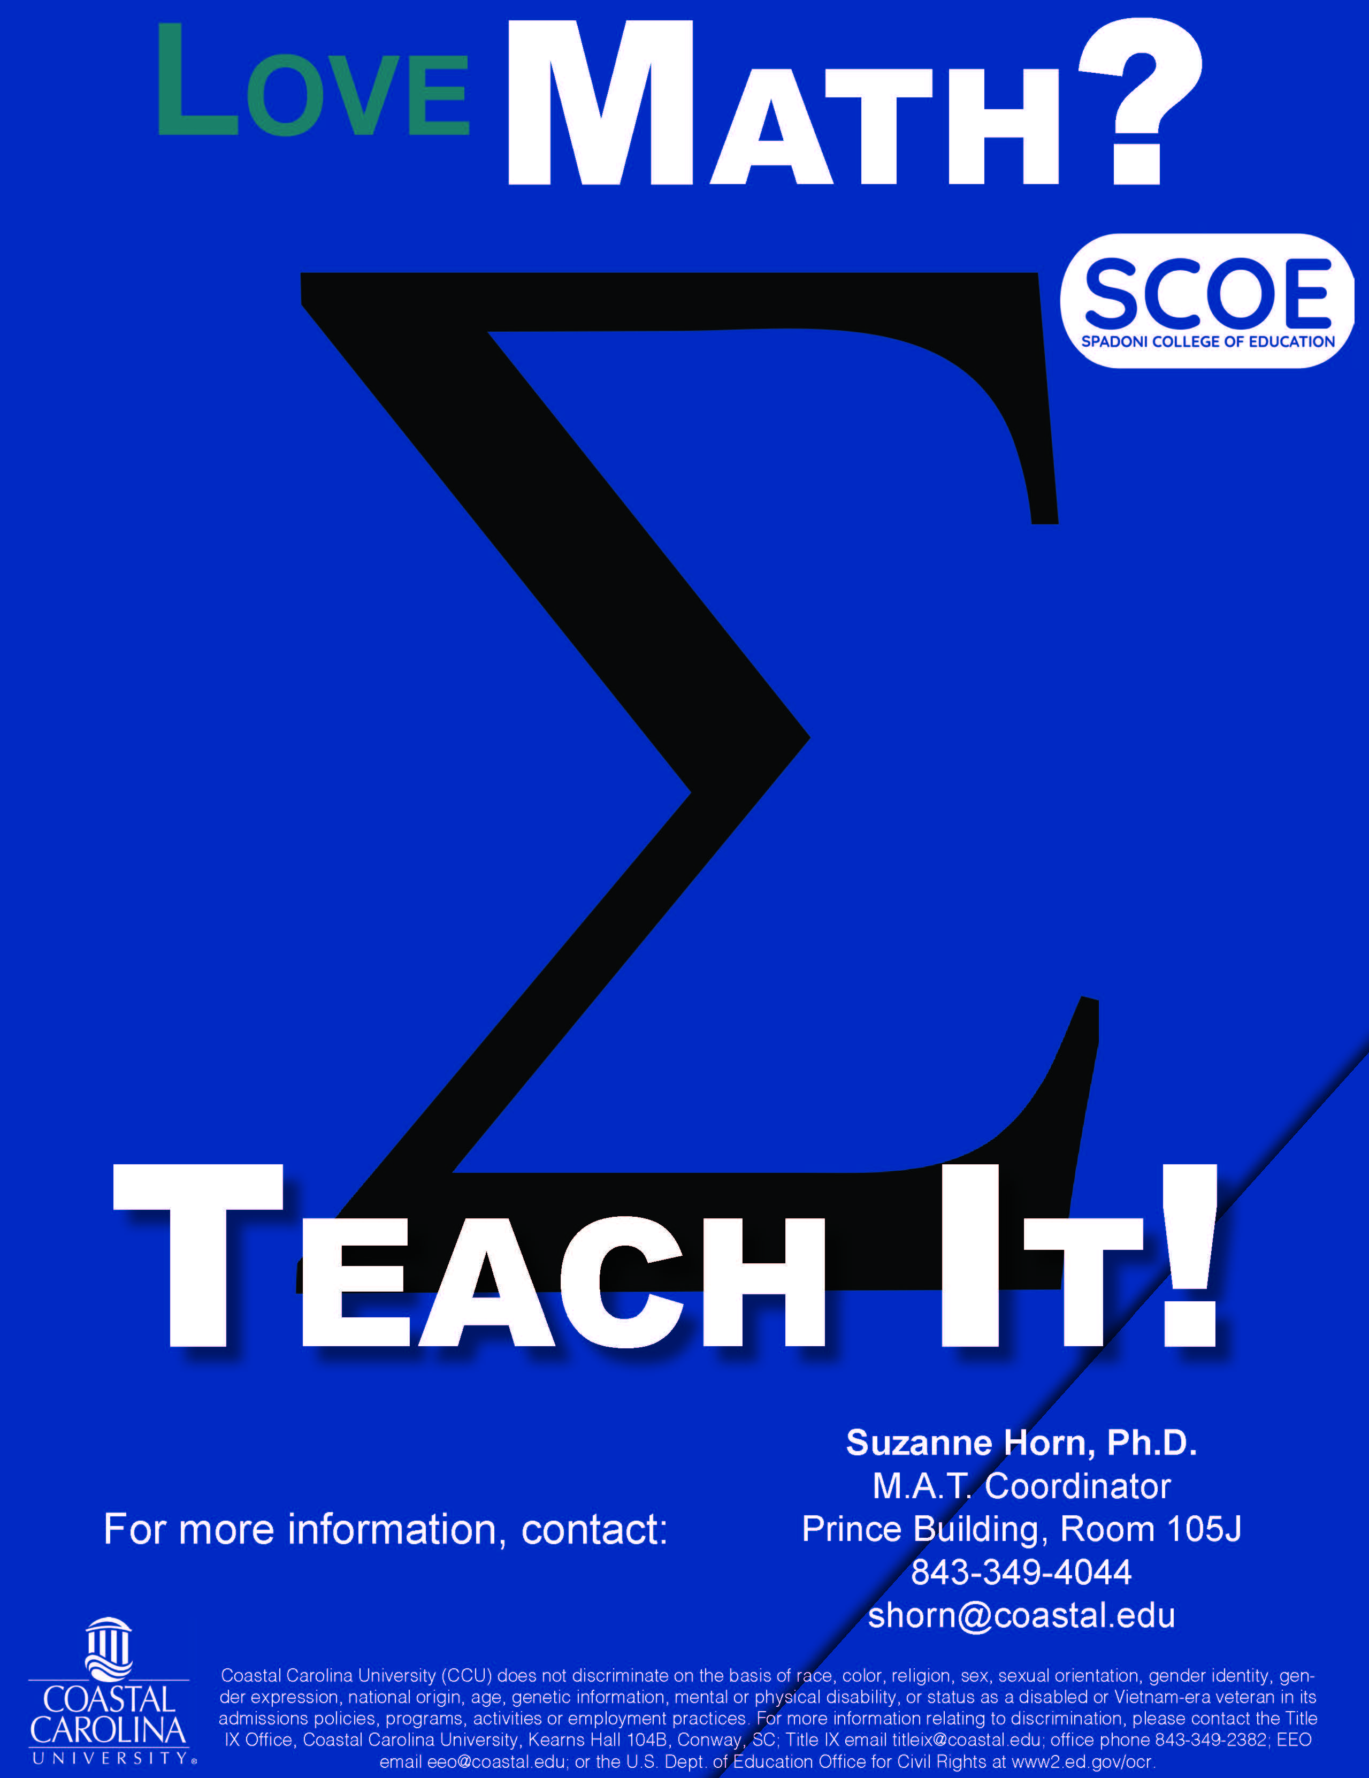
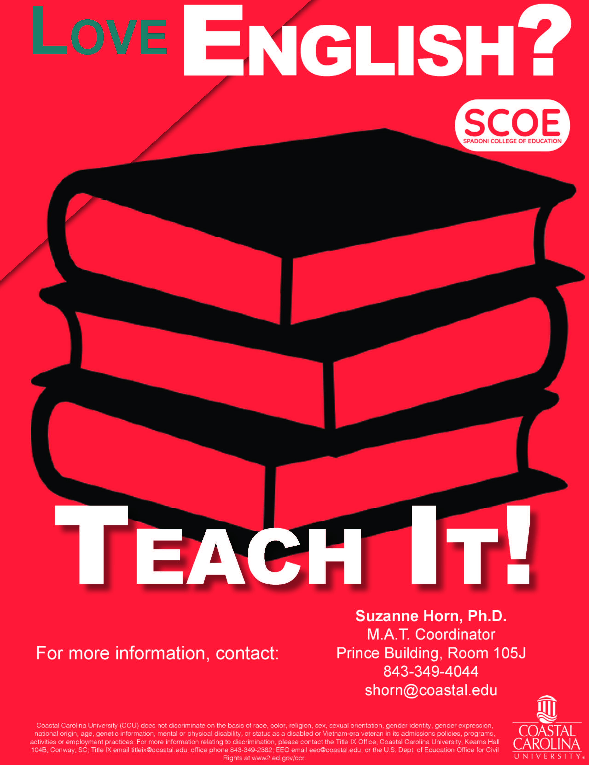
Master of Arts in Teaching
Master of Arts in Teaching
The Master of Arts in Teaching (MAT) program is an avenue to initial certification. The program starts in June and students progress through all steps to finish the following July.‌
‌‌Areas of Study
Secondary Social Studies (9-12)
Secondary Science (9-12)
Secondary Math (9-12)
Secondary English (9-12)
Students in this program must earn a baccalaureate degree, or the equivalent, in the content area of teaching specialization. Prospective students must apply to the MAT program by May 1 to enroll in the cohort that begins in the Summer I term. This 14-month full time cohort program of study includes both advanced content study at the graduate level and teaching pedagogy instruction.
Please open your chat to ask questions and visit https://www.coastal.edu/graduatestudies/ to request more information

Slide 11
Tuition Discounts
30% off for Ed.S. statewide, M.Ed. statewide.
40% off for M.Ed. in the districts of Georgetown, Horry, Florence, Dillon, Williamsburg, and Marion.
Degree or non-degree seeking are both eligible.
Please open your chat to ask questions and visit https://www.coastal.edu/graduatestudies/ to request more information

